Slide 1


DATA WAREHOUSE FOR AUTO SALES
Arina Marchenko
DECEMBER 2, 2017

Slide 2
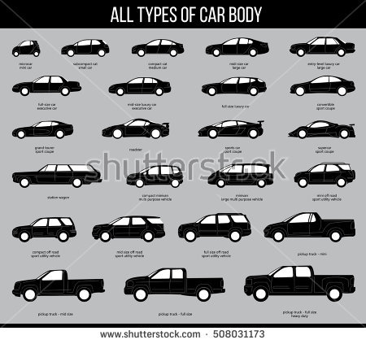

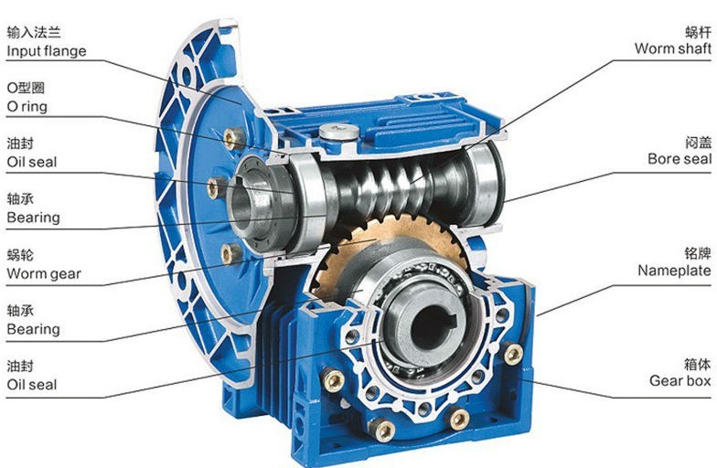
CUSTOMER PROFILE

Slide 3

Problems because of poor data management

Slide 4

DATA WAREHOUSE

Slide 5
DATA FLOW
SRC
CLS
SRC
CLS
SRC
CLS
DWH
SRC
CLS
SRC
3NF
CLS
SRC

Slide 6
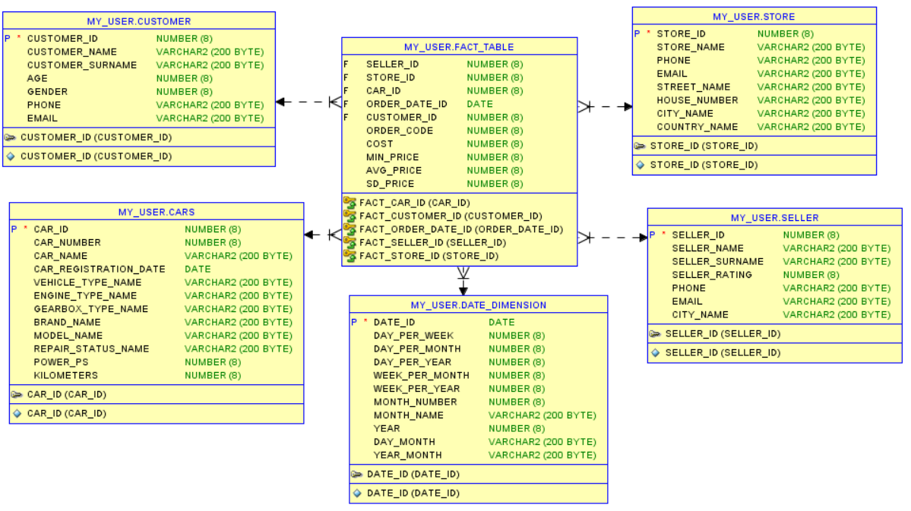
STAR SCHEMA

Slide 7
Advantages of star schema:
Higher productivity
While changes in one dimension, other will stay in the same conditional.

Slide 8
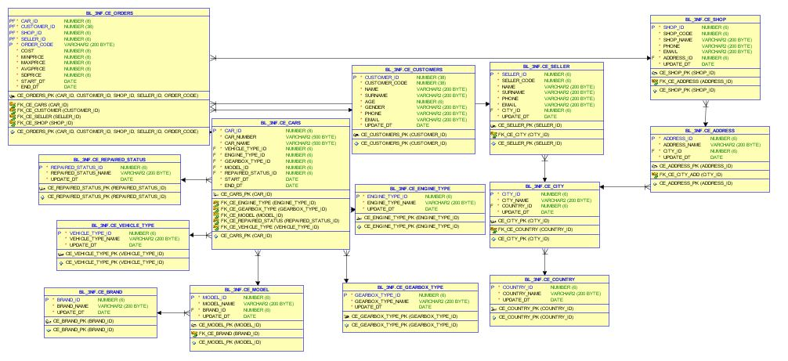
3NF

